Slide 1



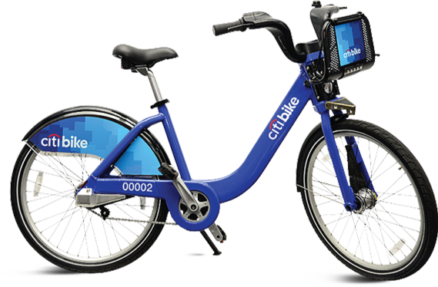
CITI BIKE
MGT 585 _GROUP 5 ​
Abhishek Manohar​
Nattayaporn Wongwilawan​
Preeti Lazarus​
Sakshi Jaiswal​
Salha Ayman M Ajabnoor​

Slide 2


Our Objective
To find the number of bikes to stock in each station at the beginning of the day to maximize the number of daily bike trips.
1
2
How many trips between stations (demand for bikes) every day (morning and evening)?
How many bikes do we have to allocate to each station?
MGT 585 Fundamentals of Business Analytics – Group 5

Slide 3


Descriptive Analysis
MGT 585 Fundamentals of Business Analytics – Group 5

Slide 4
Compute Descriptive Statistics:
I. Univariate :
Demand:
Mean of Demand | Standard Deviation
45.3625 | 32.62341
The highest DistanceMiles for StartStationName and EndStationName
StartStationName | EndStationName
West St & Chambers St | W 129 St & Convent Ave
MGT 585 Fundamentals of Business Analytics – Group 5

Slide 5
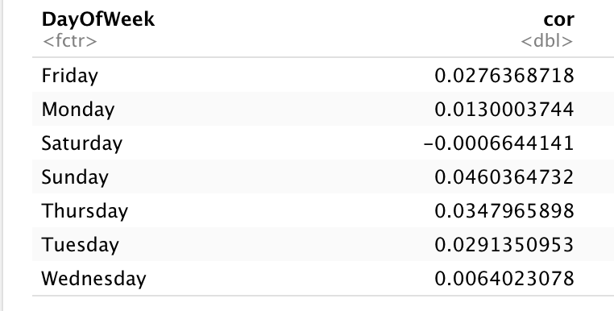
Compute Descriptive Statistics:
II. Bivariate:
Correlation between demand and temperature based on demand time:
Daytime | Evening
0.004216582 | 0.013552563
Correlation between demand and temperature based on day of week :
MGT 585 Fundamentals of Business Analytics – Group 5

Slide 6
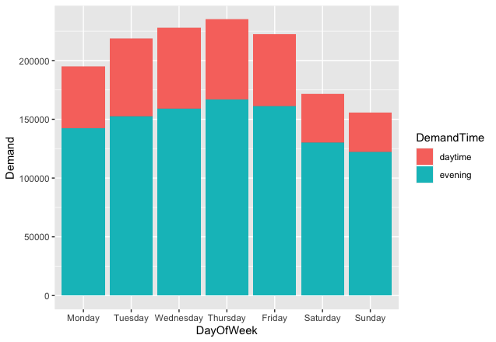
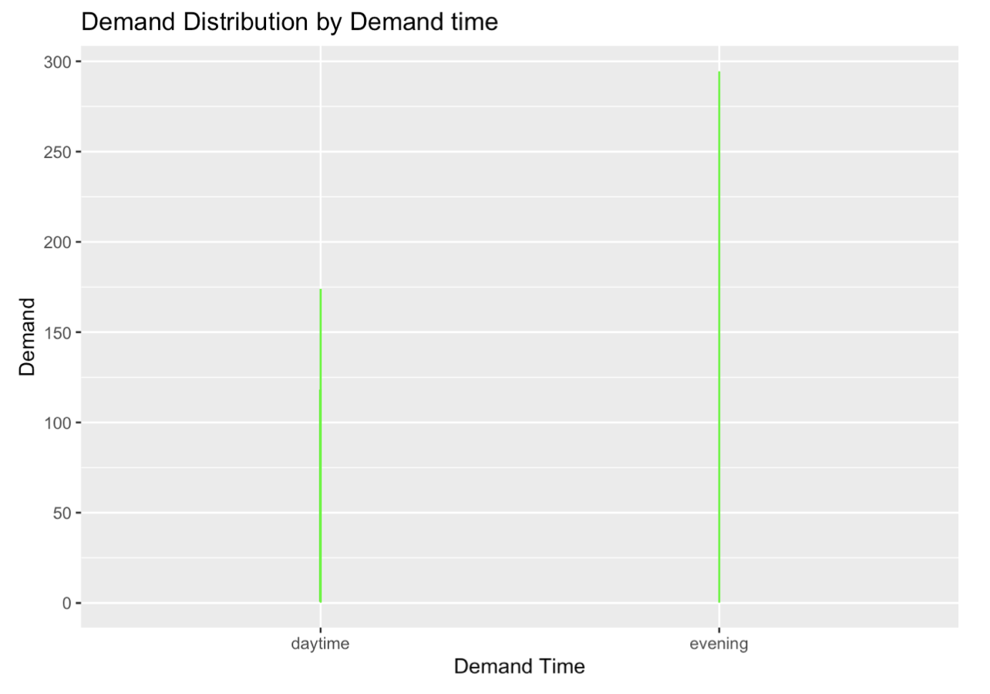
Descriptive Analysis
MGT 585 Fundamentals of Business Analytics – Group 5

Slide 7
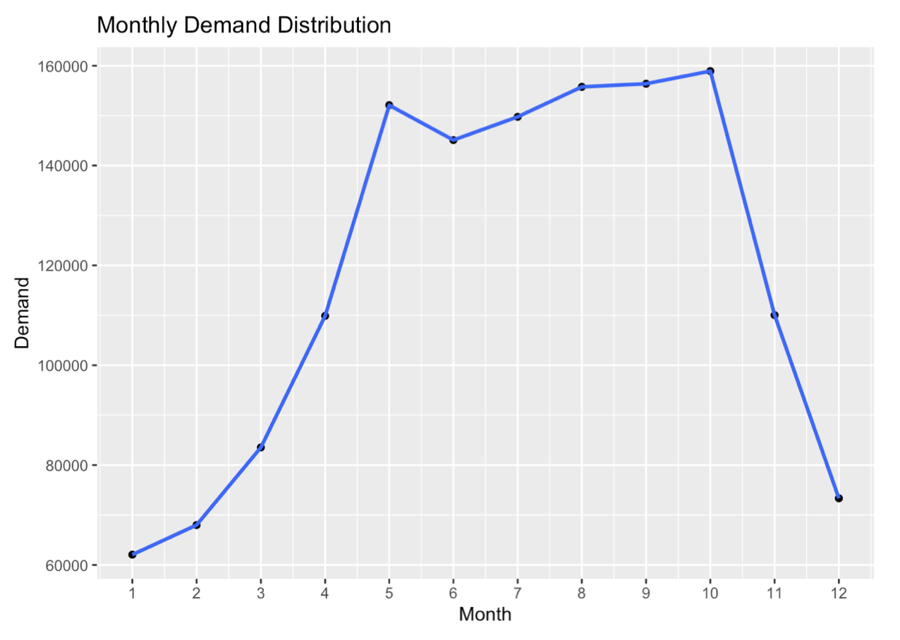
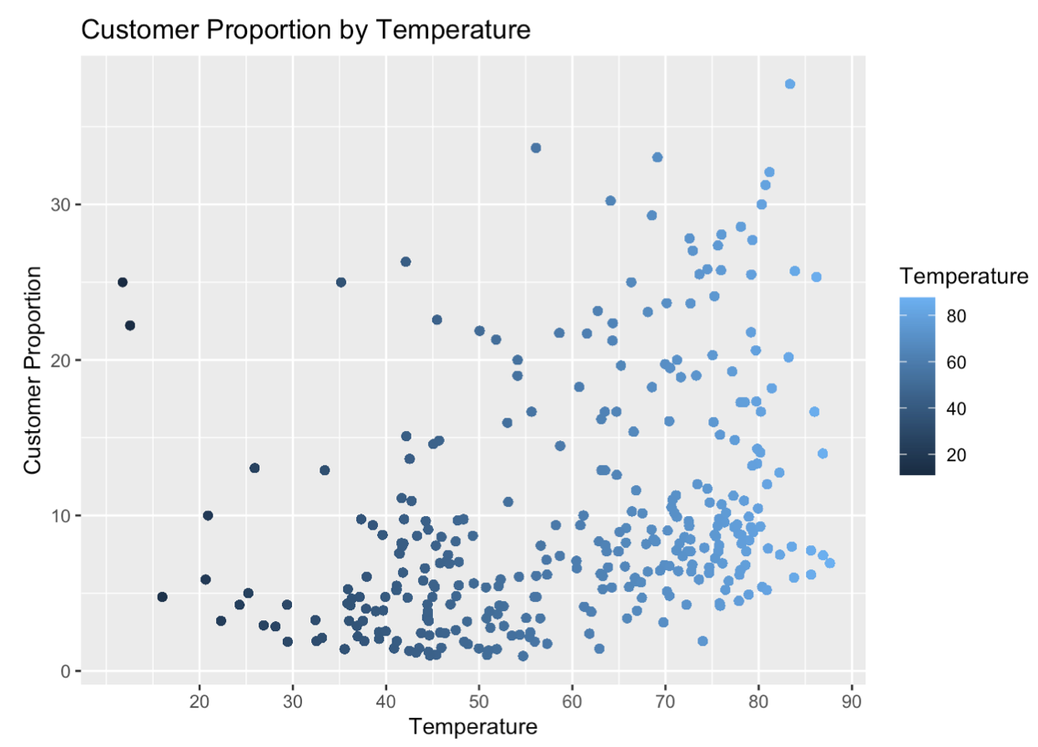
Descriptive Analysis
MGT 585 Fundamentals of Business Analytics – Group 5

Slide 8
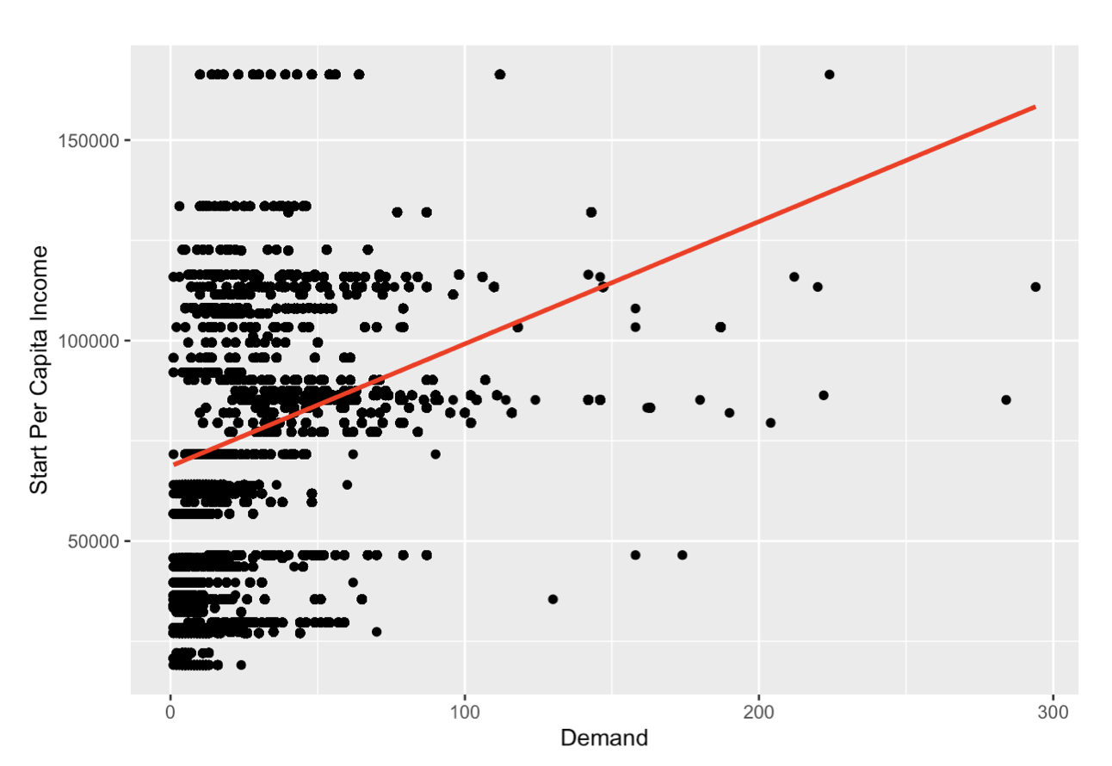
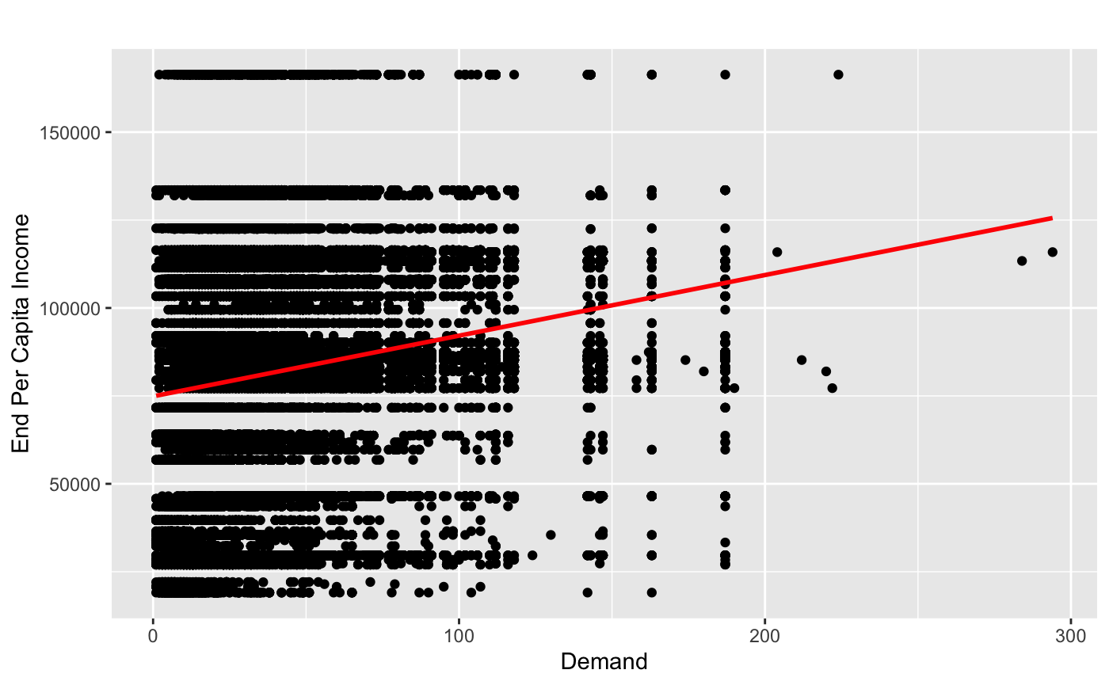
Descriptive Analysis
MGT 585 Fundamentals of Business Analytics – Group 5

Slide 9

Predictive
Analysis
MGT 585 Fundamentals of Business Analytics – Group 5

Slide 10
Predictive Analysis
Choosing 5 stations based on the highest demand:
519 , 402 , 435 , 426 , 497
Building regression:
Demand as response
DemandTime , StartStationId , EndStationId, Temperature, DayOfWeek as predictors
Choosing a random day on the future: May 25, 2019, Saturday at 70°F
MGT 585 Fundamentals of Business Analytics – Group 5

Slide 11
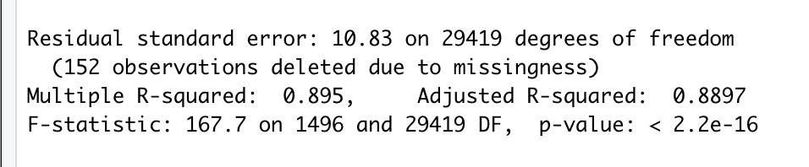
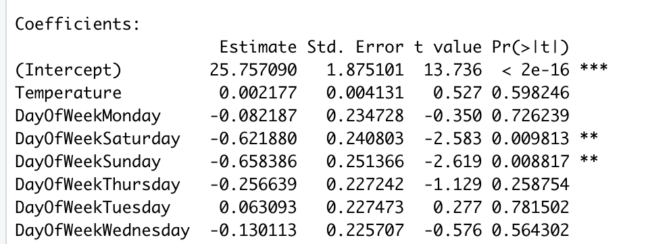
Predictive Analysis
The result:
Good Fit!
Valid model!
MGT 585 Fundamentals of Business Analytics – Group 5

Slide 12
Predictive Analysis
Morning demand
Destination Station
 | 519 | 402 | 435 | 426 | 497 | Total
519 | 149 | 147 | 147 | 148 | 148 | 739
402 | 124 | 122 | 121 | 123 | 123 | 613
435 | 111 | 109 | 108 | 110 | 110 | 548
426 | 108 | 106 | 106 | 107 | 107 | 534
497 | 108 | 106 | 106 | 108 | 107 | 535
Total | 600 | 590 | 588 | 596 | 595 | 2969
Origin
Station
Trips
MGT 585 Fundamentals of Business Analytics – Group 5

Slide 13
Predictive Analysis
Evening demand
Destination Station
 | 519 | 402 | 435 | 426 | 497 | Total
519 | 169 | 167 | 166 | 168 | 168 | 838
402 | 143 | 141 | 141 | 143 | 142 | 710
435 | 130 | 128 | 128 | 130 | 129 | 645
426 | 128 | 126 | 125 | 127 | 127 | 633
497 | 128 | 126 | 125 | 127 | 127 | 633
Total | 698 | 688 | 685 | 695 | 693 | 3459
Origin
Station
Trips
2969 + 3459 = 6,428 trips
MGT 585 Fundamentals of Business Analytics – Group 5

Slide 14

Prescriptive
Analysis
MGT 585 Fundamentals of Business Analytics – Group 5

Slide 15
Prescriptive Analysis
The number of bikes to be allocated is 1000
Station | Initial Allocation
519 | 0
402 | 465
435 | 0
426 | 0
497 | 535
Total | 1,000
Number of trips
2,000
MGT 585 Fundamentals of Business Analytics – Group 5

Slide 16

Recommendation
Station | Initial Allocation
519 | 0
402 | 465
435 | 0
426 | 0
497 | 535
Total | 1,000
Station | Initial Allocation
519 | 304
402 | 613
435 | 548
426 | 0
497 | 535
Total | 2,000
2,000 trips
4,000 trips
MGT 585 Fundamentals of Business Analytics – Group 5

Slide 17
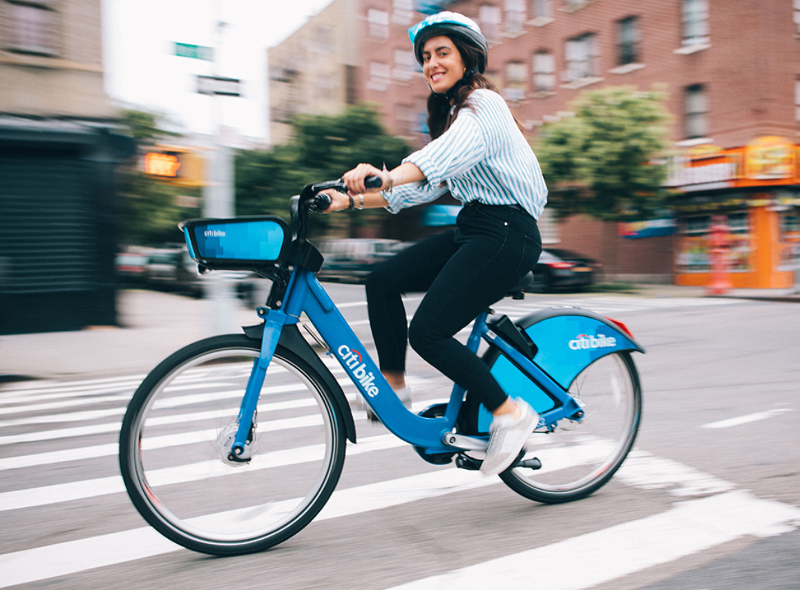


Thank you!
MGT 585 Fundamentals of Business Analytics – Group 5

Slide 18
Resources:
https://www.wunderground.com/calendar/us/ny/new-york-city/KLGA/date/2019-5
MGT 585 Fundamentals of Business Analytics – Group 5

